Slide 1

AWS Lambda
Beginner to Expert

Slide 2

HELLO!
I’m Daniel
Senior Software Engineer
youtube.com/c/beabetterdev

Slide 3
COURSE INTRODUCTION
Approach, Teaching Format, Content, Pre-requisites

Slide 4
Course Introduction
Teach you the fundamentals of AWS Lambda
Emphasis on the important bits
Visual Learning
Console Walkthroughs
Cloud Development Kit for Infrastructure as Code

Slide 5
Course Contents
Introduction
Key Concepts
Advanced Concepts
What is a Lambda Function?
Configuration
Invocation Types
A Brief Tour of the Console
Deployments
Throttling & Concurrency
How does it work?
Monitoring
Performance Tuning
Good to Knows
Service Integrations
IaC with CDK
Event Processing & Workflows
Pricing
APIs & Adhoc Jobs
Timed Jobs
Notes:
DONT FORGET WHY THEY ARE USEFUL

Slide 6
Who Are You?
Developers
Data Engineers & Scientists
Devops
Other Industry Professional
Folks starting a new job and looking to ramp up quickly

Slide 7
Pre-requisites
Python Fundamentals
Functions, variables primitives, etc...
General Understanding of AWS
Python, PIP, AWS CLI, CDK
AWS Account

Slide 8
The Value of Learning Lambda
Massive Industry Adoption
Applications in Many Job Families
Extensive Community Support
Lower Cost vs Traditional Bare Metal

Slide 9
Introduction to AWS Lambda

Slide 10
Agenda
What is AWS Lambda?
Why is Lambda Useful?
Disadvantages
Who Uses Lambda?

Slide 11

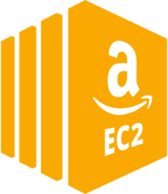

History of AWS Lambda
Early 2000s
Mid to Late 2000s
2014+
Traditional Company Specific
Data Centers
Early Cloud Infrastructure
(EC2)
Enhanced
Cloud Infrastructure
Notes:
Talk about language support

Slide 12
What is AWS Lambda?
Compute Service
Run code at scale without worrying about servers
You write Functions - the primary unit of Lambda
Useful in many applications such as
API Hosting
Event Processing
Ad-hoc or timer based jobs
Notes:
Compute service - Launched in 2014. Predecessor is EC2 which is the traditional infrastructure model.
Offers many languages

Slide 13


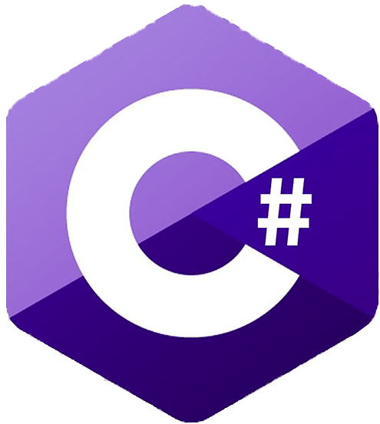

A Typical Workflow
1
2
3
Create a Function
Write & Upload Your Code
Run Your Function
Notes:
Talk about language support

Slide 14

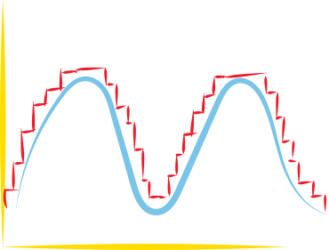





Why is Lambda Useful?
No Servers to Manage
Autoscaling
Pay For What You Use
Performance
Service Integrations
Easy To Use
Notes:
DONT FORGET WHY THEY ARE USEFUL

Slide 15
“With AWS Lambda, you gain flexibility at the expense of control.”

Slide 16







Users of AWS Lambda
Notes:
Talk about language support

Slide 17
How Lambda Works Under The Hood

Slide 18
Under The Hood
Create Function
arn:aws:lambda:us-east-1:755314965794:function:DemoAppLambda
Lambda Holding Pool
invoke
Load Balancer

Slide 19
Core Concepts - Triggers

Slide 20

Not like this...
BREAK
SECTION
A company is an association or collection of individuals, whether natural persons, legal persons, or a mixture of both. Company members share a common purpose and unite in order to focus their various talents.

Slide 21
What is a Trigger?
Means to Invoke your Function
SDK, CLI, Console, Service Integration
Can have many triggers
Similar concept called Event Source Mapping
Different Triggers have different scaling / retry behaviour
Notes:
https://docs.aws.amazon.com/lambda/latest/dg/lambda-invocation.html

Slide 22



Don’t Try to Do This
Cloudwatch Event
API Gateway

Slide 23
Common Triggers / Event Source Mappings
Cloudwatch Events for Timer based jobs
API Gateway for REST APIs
SNS or SQS for event processing
DynamoDB Streams for Record Changes
S3 for Object Creation / Updates
Notes:
https://docs.aws.amazon.com/lambda/latest/dg/lambda-invocation.html

Slide 24
Core Concepts - Invocation Types
Synchronous and Asynchronous

Slide 25


Synchronous
Asynchronous
request
request
process
reply
success or failure
reply
success or failure
How do we handle failure?
Dead Letter Queue
Notes:
https://docs.aws.amazon.com/lambda/latest/dg/lambda-invocation.html

Slide 26
Why does this matter?
Synchronous can have cost implications
Asynchronous can be more suitable for fault tolerant use cases
Different Failure Behaviours
Notes:
https://docs.aws.amazon.com/lambda/latest/dg/lambda-invocation.html

Slide 27
Real Life Example
Event Processing System With Multiple Lambdas calling each other
Initially Used Synchronous… Whoops
Switched to Async and Voila...
Notes:
https://docs.aws.amazon.com/lambda/latest/dg/lambda-invocation.html

Slide 28
Core Concepts - Duration / Timeouts

Slide 29

BREAK
SECTION
A company is an association or collection of individuals, whether natural persons, legal persons, or a mixture of both. Company members share a common purpose and unite in order to focus their various talents.
We all have our Limits

Slide 30
Lambda Duration Limits
Maximum 15 minutes before automatic timeout
This means Lambda are not suitable for long running processes
Lambdas will automatically Timeout when the configured limit is reached
Default is 3 seconds - Configurable via Console
Notes:
https://docs.aws.amazon.com/lambda/latest/dg/lambda-invocation.html

Slide 31
Pro Tips
Longer timeouts aren’t always better
Background (asynchronous) processes are also terminated
Notes:
https://docs.aws.amazon.com/lambda/latest/dg/lambda-invocation.html

Slide 32
Core Concepts - Memory

Slide 33

Who Remembers These?
BREAK
SECTION
A company is an association or collection of individuals, whether natural persons, legal persons, or a mixture of both. Company members share a common purpose and unite in order to focus their various talents.

Slide 34
Lambda Memory
Defines the amount of memory available to your function at runtime
Range between 128 MB and 10,240 MB
Changing Memory is the most significant performance lever available to you
Increasing memory determines instance type behind the scenes
Notes:
https://docs.aws.amazon.com/lambda/latest/dg/configuration-memory.html

Slide 35
Pro Tips
Increasing memory setting can reduce the impact of cold start
Can also help with Networking Connectivity Speed
Memory increase doesn’t result in linear performance gain
You should try and find the sweet spot to balance performance and invocation duration
Notes:
https://docs.aws.amazon.com/lambda/latest/dg/lambda-invocation.html

Slide 36
Side Topic - Pricing

Slide 37
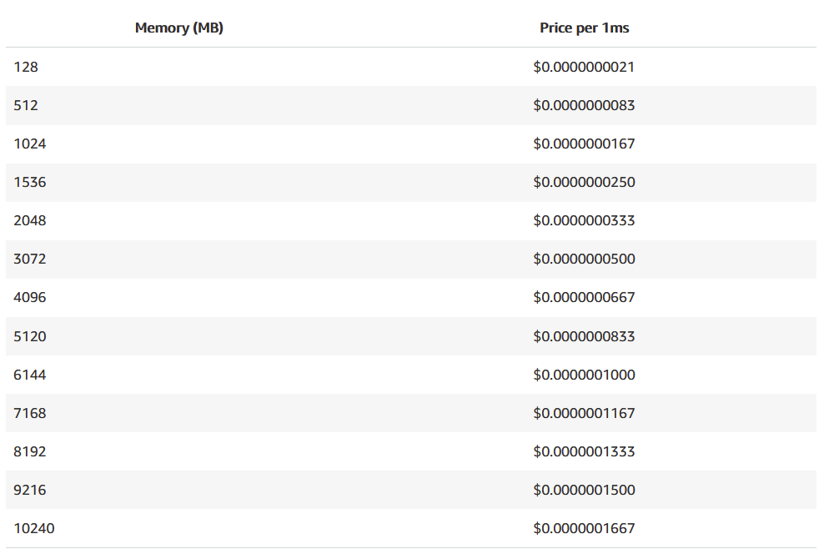
Invocation Count
Memory
Duration
The number of times you invoke the function
The amount of memory you provision
How long your invocations run for
$.20 per 1 Million Requests
$.0000166667 per GB Second
Notes:
https://docs.aws.amazon.com/lambda/latest/dg/lambda-invocation.html

Slide 38
3 Million Invocations
512 MB Memory
1 Second Duration
$18.74 / month

Slide 39
30 Million Invocations
128 MB Memory
200ms Duration
$11.63 / month

Slide 40
To Estimate Your Costs
Use the Cost Calculator!
https://aws.amazon.com/lambda/pricing/
Notes:
https://docs.aws.amazon.com/lambda/latest/dg/lambda-invocation.html

Slide 41
Pro Tips
Start with low memory settings
Once you collect enough invocation history, use the Compute Optimizer Tool
1 Million free requests per month and 400,000 GB Seconds
Notes:
https://docs.aws.amazon.com/lambda/latest/dg/lambda-invocation.html

Slide 42
Core Concepts - Function Execution & Cold Start

Slide 43
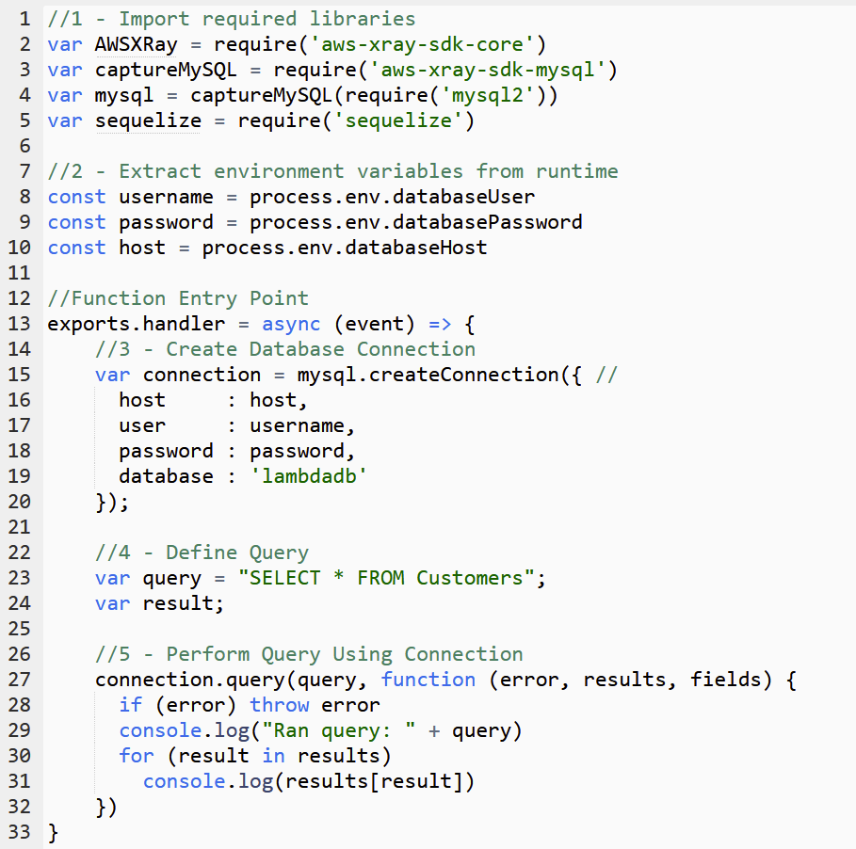
Decomposing a Function Execution
Code Download
Start Execution
Environment
Execute Init
Code
Execute Handler
Code
1
2
3
4
Full Cold Start
Partial Cold
Start
Warm Start

Slide 44

Cold Start also occurs while scaling up

Slide 45
Strategies to Minimize Cold Start
Minimize number of library dependencies
Only import what you need
Raise Memory Configuration
Utilize Provisioned Concurrency
Notes:
When lambda is invoked, lambda finds an instance to process the event, lambda downloads your code, and starts a new execution environment.

Slide 46
Example - Querying a Database
Notes:
When lambda is invoked, lambda finds an instance to process the event, lambda downloads your code, and starts a new execution environment.

Slide 47
Core Concepts - Concurrency & Throttling

Slide 48
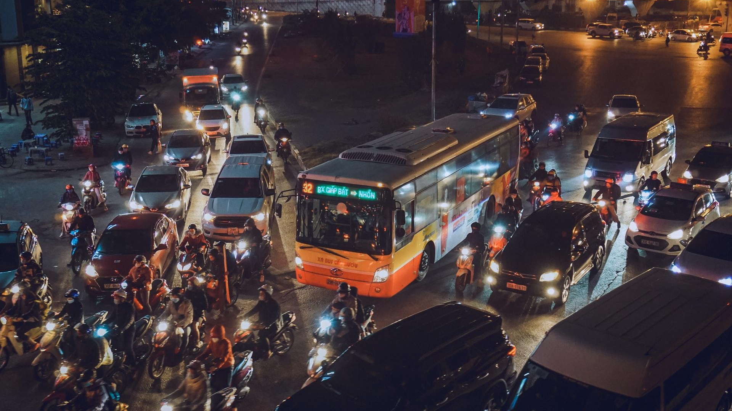
BREAK
SECTION
A company is an association or collection of individuals, whether natural persons, legal persons, or a mixture of both. Company members share a common purpose and unite in order to focus their various talents.

Slide 49
What is Lambda Concurrency?
# of requests being served at a given moment
New containers are spawned for each concurrent request
Concurrency is a major scaling consideration, and can cause applications to fail due to Throttling
Default 1000 units of concurrency per AWS account per region
Unreserved, Reserved, and Provisioned
Notes:
When lambda is invoked, lambda finds an instance to process the event, lambda downloads your code, and starts a new execution environment.

Slide 50
Throttling aka RateExceeded
Throttling is when Lambda rejects a request
Occurs when in flight invocations exceeds available concurrency
Notes:
https://docs.aws.amazon.com/lambda/latest/dg/lambda-invocation.html

Slide 51
Unreserved
Reserved
Provisioned
Common concurrency pool
Dedicated concurrency pool
Dedicated and ‘always on’ concurrency pool
Notes:
https://docs.aws.amazon.com/lambda/latest/dg/lambda-invocation.html

Slide 52
Core Concepts - Reserved & Unreserved
Concurrency

Slide 53

Unreserved Concurrency
Free for all among all functions in an account per region
If one function consumes all concurrency, the others will get throttled
Limit can be raised via AWS Support Ticket
Notes:
https://docs.aws.amazon.com/lambda/latest/dg/lambda-invocation.html

Slide 54
Reserved Concurrency
A portion is always reserved for a specific function, even if there are no invocations
You can use reserved concurrency to minimize or maximize your processing rate
Good for predictable resource allocation
Bad in terms of utilization of resources
Notes:
https://docs.aws.amazon.com/lambda/latest/dg/lambda-invocation.html

Slide 55
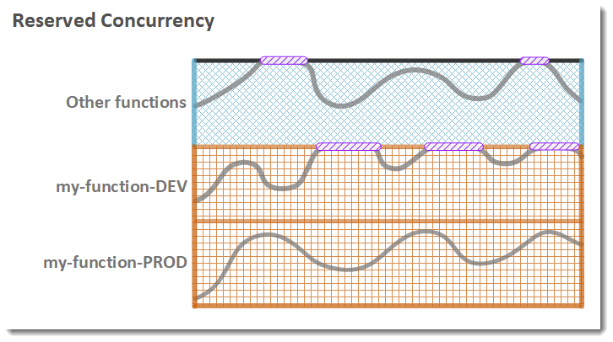
Reserved
Function Concurrency
Reserved Concurrency
Unreserved Concurrency
Throttling
Notes:
https://docs.aws.amazon.com/lambda/latest/dg/lambda-invocation.html

Slide 56
Core Concepts - Provisioned Concurrency

Slide 57
Provisioned Concurrency
Pool of concurrency that is ‘always on’
Solves the Cold Start problem, kinda
Supports autoscaling policies based on usage
Very expensive (34$/month for 5 units always on)
Blurs the line between serverless and metal
Notes:
https://docs.aws.amazon.com/lambda/latest/dg/lambda-invocation.html

Slide 58
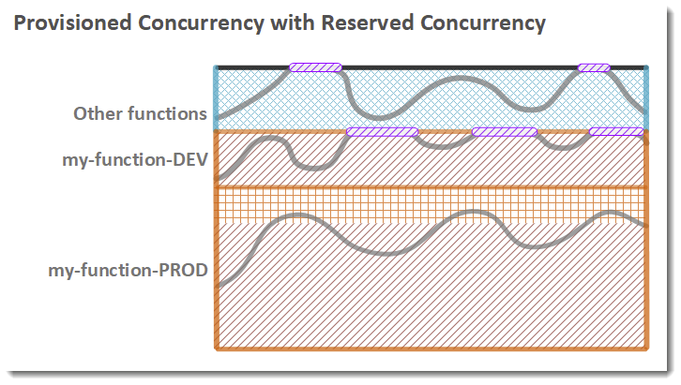
Provisioned with Reserved
Function Concurrency
Reserved Concurrency
Provisioned Concurrency
Unreserved Concurrency
Throttling
Notes:
https://docs.aws.amazon.com/lambda/latest/dg/lambda-invocation.html

Slide 59
Pro Tips
Alarm on throttles for early indicators of issues
Evaluate your concurrency needs and plan accordingly
Have your clients use Exponential Backoff to avoid retry storms
Raising your Memory Limit can help, but be careful
Use a small amount of provisioned concurrency to mitigate cold starts for latency sensitive apps
Notes:
https://docs.aws.amazon.com/lambda/latest/dg/lambda-invocation.html

Slide 60
Core Concepts - Versions

Slide 61

BREAK
SECTION
A company is an association or collection of individuals, whether natural persons, legal persons, or a mixture of both. Company members share a common purpose and unite in order to focus their various talents.

Slide 62
Versions
Versions are snapshots of the code and settings of a function.
Code and settings get locked to a version on publish
Allow you to have multiple ‘versions’ of a function at the same time - useful for quick rollbacks
New uploads default to $LATEST version
arn:aws:lambda:us-east-1:755314965794:function:DemoAppLambda:1

Slide 63
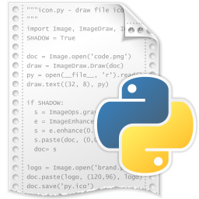
Versions - Example
Version
1
$LATEST
V1
2
$LATEST
V2
3
$LATEST
V3
Notes:
https://docs.aws.amazon.com/lambda/latest/dg/lambda-invocation.html

Slide 64
Core Concepts - Aliases

Slide 65
Aliases
An Alias is a named pointer to a specific Version
arn:aws:lambda:us-east-1:755314965794:function:DemoAppLambda:1
Useful for ‘beta’ testing, or ‘pre-prod’ environments
Notes:
https://docs.aws.amazon.com/lambda/latest/dg/lambda-invocation.html

Slide 66
Aliases - Example
Version
Alias
1
$LATEST
prod
V1
2
$LATEST
V2
3
$LATEST
prod
V3
Notes:
https://docs.aws.amazon.com/lambda/latest/dg/lambda-invocation.html

Slide 67
Advanced Concept - Version/Alias Weights
You can assign weights to different versions using a Version/Alias
90% of Traffic to Version 1, 10% to Version 2
Useful for version validation prior to full blown deployment
You need to use Aliases/Versions in order to use Provisioned Concurrency
Notes:
https://docs.aws.amazon.com/lambda/latest/dg/lambda-invocation.html

Slide 68
Core Concepts - Environment Variables

Slide 69
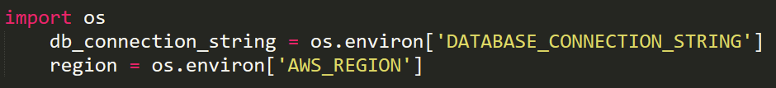
Environment Variables
Pairs of Strings with a key and value
Allow you to adjust function behavior without touching your code
Examples
STAGE
CLIENT_ENDPOINT_URL
DATABASE_CONNECTION_STRING
Notes:
https://docs.aws.amazon.com/lambda/latest/dg/lambda-invocation.html

Slide 70

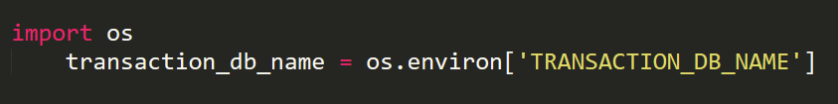
An Example
TransactionDB-DEV
TransactionDB-PROD
TransactionProcessorLambda-DEV
TransactionProcessorLambda-PROD
DEVELOPMENT
PRODUCTION
Notes:
https://docs.aws.amazon.com/lambda/latest/dg/lambda-invocation.html

Slide 71
Core Concepts - VPC & Networking

Slide 72
VPC - Quick Refresher
Stands for Virtual Private Cloud
Isolated and private network within AWS
Public and Private Subnets
Critical for security and apps with compliance guidelines
Notes:
https://docs.aws.amazon.com/lambda/latest/dg/lambda-invocation.html

Slide 73
VPC and Lambda
Only Necessary when your function needs to access resources not accessible over public internet
Example: RDS or ElasticSearch in private subnet
Behind the scenes, Lambda creates ENIs for each subnet the function is deployed into
No longer contributes to cold start latency
VPC Endpoints can be used to communicate with some AWS services privately
Notes:
ALSO POSSIBLE TO EXPOSE YOUR FUNCTION THATS IN A VPC TO THE PUBLIC INTERNET.
The network interface creation happens when your Lambda function is created or its VPC settings are updated. When a function is invoked, the execution environment simply uses the pre-created network interface and quickly establishes a network tunnel to it. This dramatically reduces the latency that was previously associated with creating and attaching a network interface at cold start.
https://aws.amazon.com/blogs/compute/announcing-improved-vpc-networking-for-aws-lambda-functions/

Slide 74


Example
VPC
Internet Gateway
NAT Gateway
Public Subnet
Private Subnet
S3
Notes:
ALSO POSSIBLE TO EXPOSE YOUR FUNCTION THATS IN A VPC TO THE PUBLIC INTERNET.
LAMBDAS CANNOT HAVE A PUBLIC IP, so NAT GATEWAY IS REQUIRED - https://stackoverflow.com/questions/52992085/why-cant-an-aws-lambda-function-inside-a-public-subnet-in-a-vpc-connect-to-the
“If your Lambda function doesn't actually need to reach private resources inside your VPC then you typically don't need to attach the Lambda to the VPC. But if it does need to, then attach the Lambda function to a private subnet and ensure a default route from that subnet to a NAT instance or NAT Gateway in a public subnet. And configure an IGW, without which internet access is not possible.”

Slide 75
You Specify:
Lambda Creates:
VPC
Subnets
Security Groups
Elastic Network Interface
Notes:
DONT FORGET WHY THEY ARE USEFUL

Slide 76
Exposing Your Function to Other VPCs
Use VPC Endpoints to privately connect to AWS Lambda
Does not expose your function to the public internet
You can limit who from the corresponding VPC can call your function
Notes:
https://docs.aws.amazon.com/lambda/latest/dg/configuration-vpc-endpoints.html

Slide 77
Good To Knows
Launching in VPC can lead to longer startup times due to ENI connection overhead
Notes:
https://docs.aws.amazon.com/lambda/latest/dg/lambda-invocation.html

Slide 78
Monitoring - Key Metrics

Slide 79
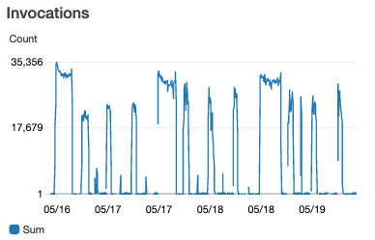
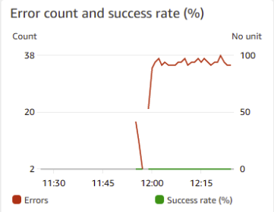
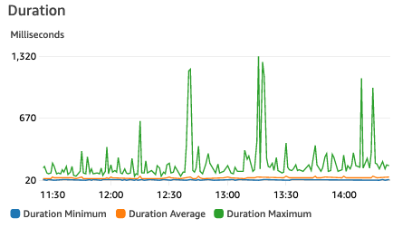
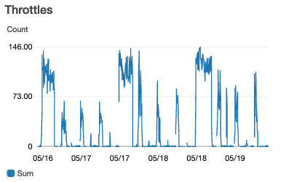
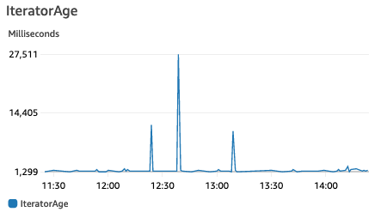
Metrics to Monitor
+ any other business
metrics!
Notes:
https://docs.aws.amazon.com/lambda/latest/dg/lambda-invocation.html

Slide 80
Important Tip
Metrics don’t help if you’re not looking at them
SETUP ALARM ON YOUR METRICS!

Slide 81
Other Notable Metrics
ConcurrentExecutions
UnreserveredConcurrentExecutions

Slide 82
Monitoring - Logging

Slide 83
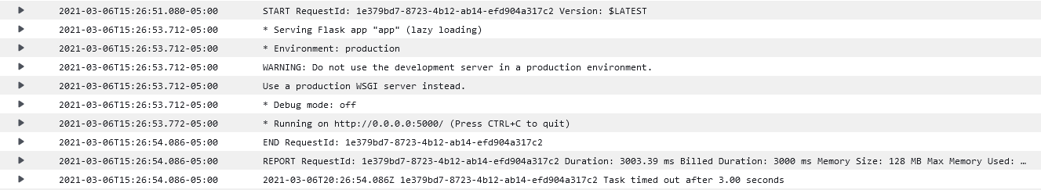
Logging
Writing to stout automatically writes logs to Cloudwatch
Log lines by default include metadata about the execution
Notes:
https://docs.aws.amazon.com/lambda/latest/dg/python-logging.html

Slide 84
Metric Filters
Allow you to write patterns (think regex) to extract metrics from log lines
Much cheaper than using PutMetric
More suitable for high TPS applications
LATENCY - CreditCardServiceLatency 990ms
ERROR - InvalidArgumentException 1

Slide 85
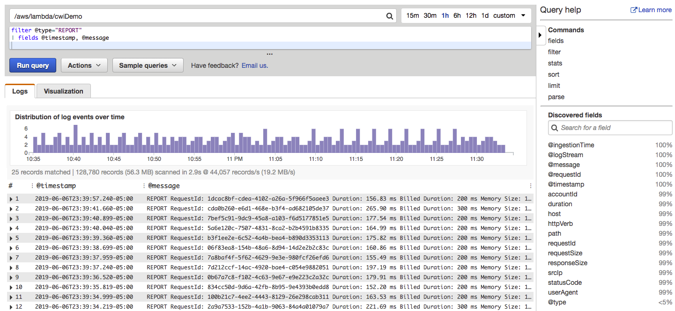
Cloudwatch Logs Insights
Search for patterns across multiple functions at once
Pay per use (amount of data scanned)
Great ‘Example Queries’ that you can build from

Slide 86
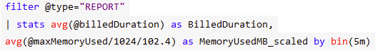
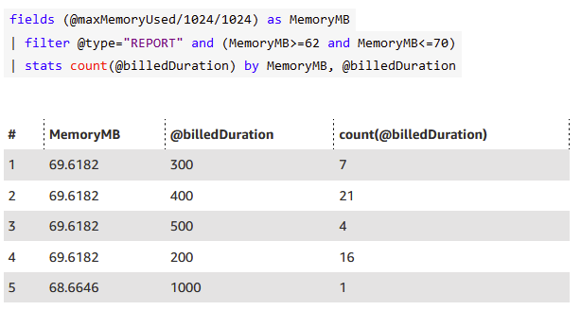
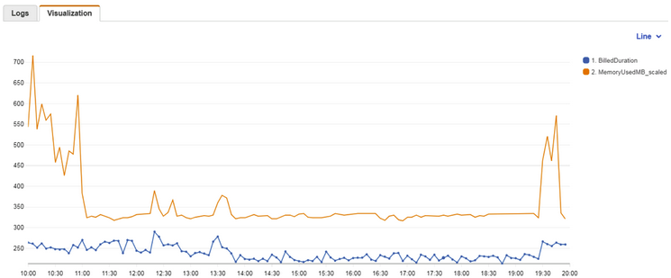
Cloudwatch Logs Insights Examples
Notes:
https://docs.aws.amazon.com/lambda/latest/dg/lambda-invocation.html

Slide 87
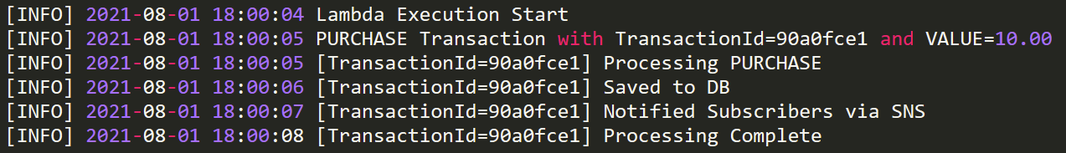
Pro Tips
Don’t be overly verbose with Logging
Embed log lines with important ids to make tracing easier
Use Cloudwatch Logs Insights for fuzzy searching
Set up a log retention policy or archive regularly

Slide 88
Monitoring - Lambda Insights

Slide 89
What is Lambda Insights?
Performance Monitoring tool for Lambda
Collects, aggregates & summarizes system level metrics (CPU, Memory, Network Usage)
Embedded dashboard
Notes:
https://docs.aws.amazon.com/lambda/latest/dg/python-logging.html

Slide 90
How it works
Activating it adds a Lambda Extension to your function. Logs get emitted on every invocation.
Metrics get sent to cloudwatch and extracted with metric filter patterns
Notes:
https://docs.aws.amazon.com/lambda/latest/dg/python-logging.html

Slide 91
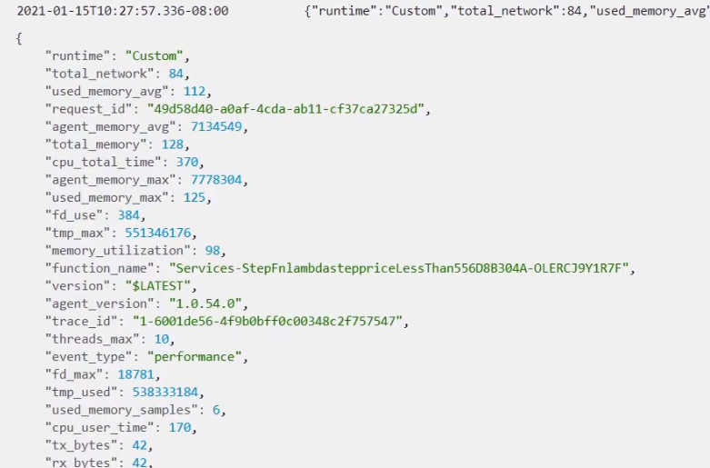
Log Entry Example

Slide 92
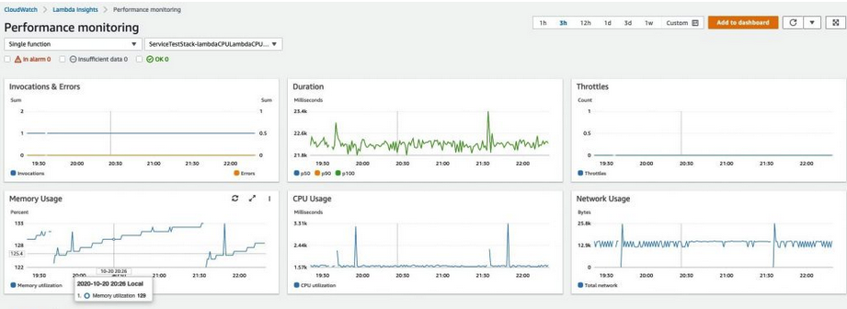
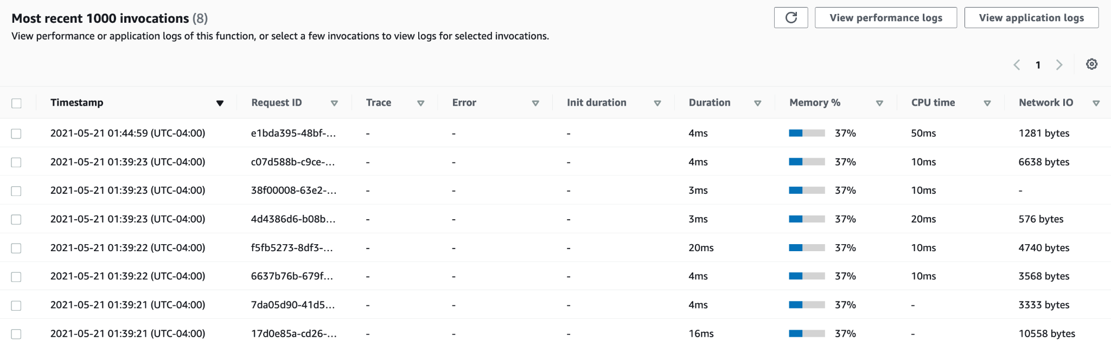

Slide 93
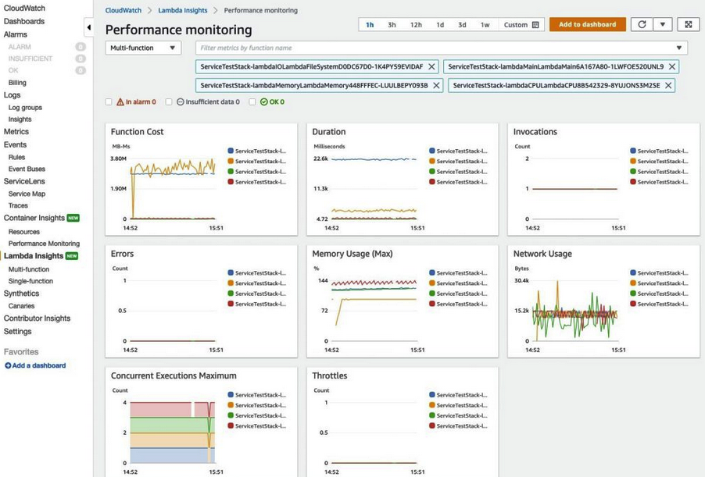

Slide 94
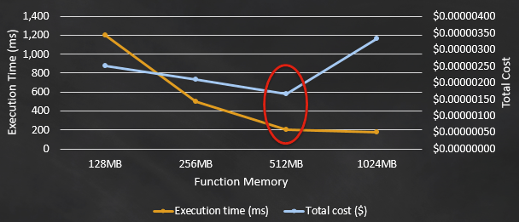
Performance Optimization
Notes:
https://docs.aws.amazon.com/lambda/latest/dg/python-logging.html

Slide 95
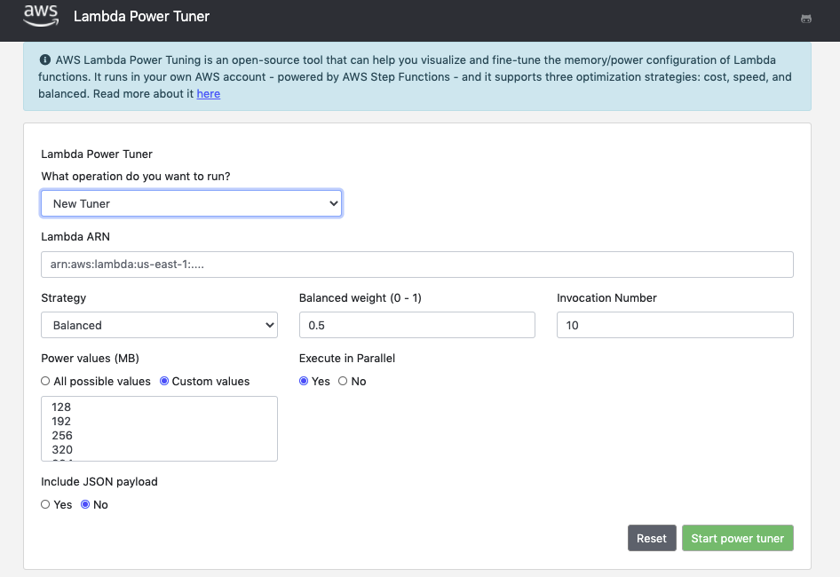
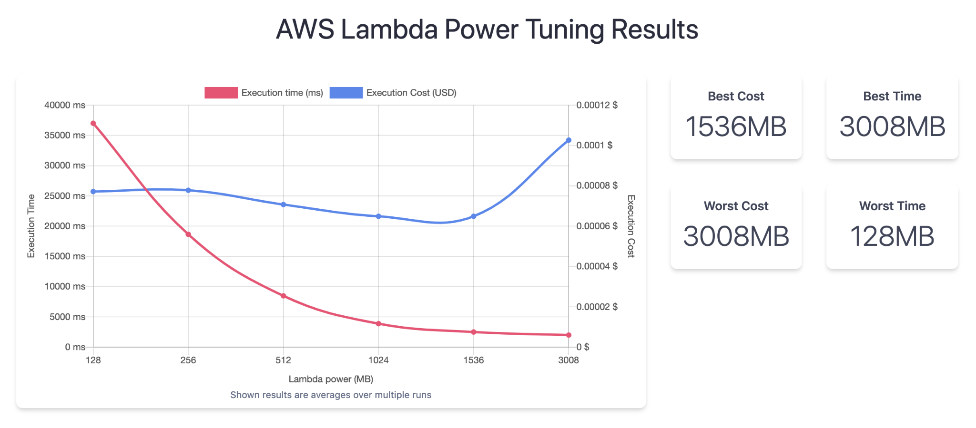
How can we pick the right value?
Option 1: Trial and Error
Option 2: Lambda Power Tuning
Notes:
https://docs.aws.amazon.com/lambda/latest/dg/python-logging.html

Slide 96
Logging - Hands On Example

Slide 97
Monitoring - X Ray Tracing

Slide 98
What is X Ray Tracing?
Application level debugging feature
Generates Trace information on your invocations
Visualization aid for understanding how much time is spent where
You can add custom segments to your code for function traces

Slide 99
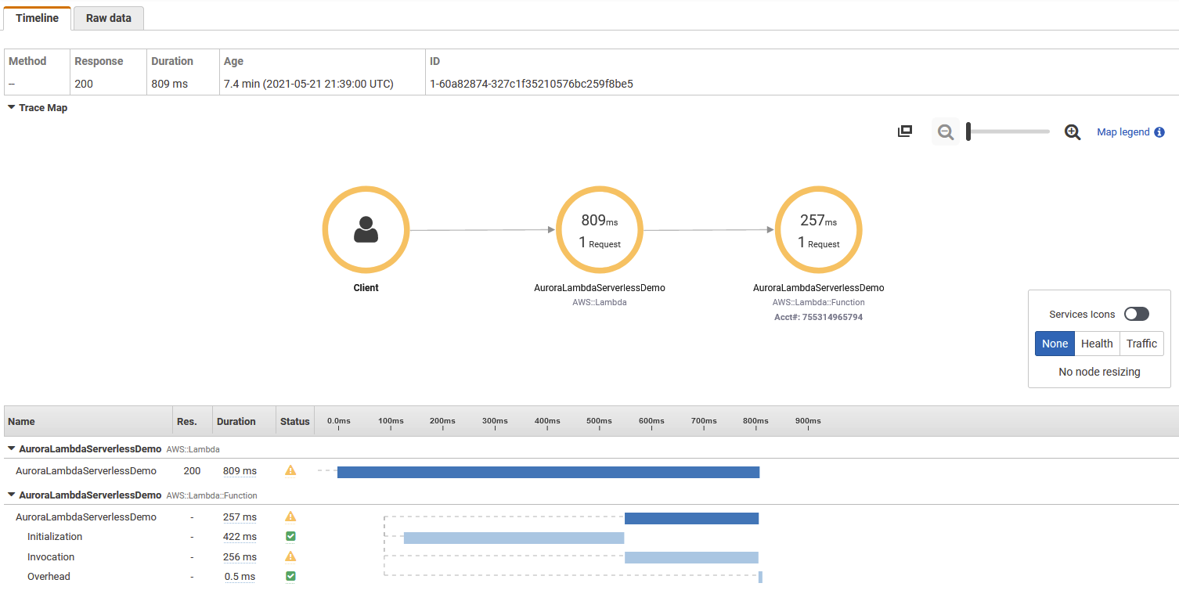
Notes:
https://docs.aws.amazon.com/lambda/latest/dg/lambda-invocation.html

Slide 100
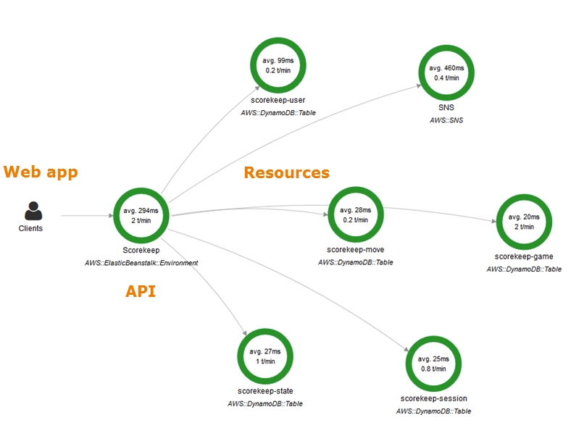
Notes:
https://docs.aws.amazon.com/lambda/latest/dg/lambda-invocation.html

Slide 101
Pro Tips
Its expensive
$5.00 / 1 million traces recorded
$0.50 / 1 million traces retrieved
$0.50 / 1 million traces scanned
More useful for ad-hoc debugging
Consider using sampling

Slide 102
Advanced Concepts - DLQ

Slide 103
What is a DLQ?
Dead Letter Queue
Sometimes dependencies fail and messages cannot be processed...
DLQ is a destination to temporarily hold failed invocation message content
After a number of attempts, messages can be sent to the DLQ for you to act on

Slide 104

Example
4. Invoke
3. Once issue is fixed, poll queue for failed messages
Method 1
1. invoke
2. On failure, send to queue
Amazon Simple Queue Service DLQ
2. On failure, lamda automatically sends to queue
Method 2
1. invoke
EventSource
Queue
EventSource
DLQ
3. Once issue is fixed, transfer messages back to main queue

Slide 105
Best Practices
Always use a DLQ for production applications
Alarm on DLQ size > 0
Be Proactive - have a process for re-driving messages

Slide 106
Advanced Concepts - RDS Proxy

Slide 107
Remember This?
invoke
Load Balancer

Slide 108
Remember This?
RDS
Proxy
invoke
Load Balancer

Slide 109
RDS Proxy Feature
Connection Pool Manager for RDS that integrates directly with Lambda
Can be used with RDS MySQL, Postgres or Aurora
If deciding to not use this feature, be careful with connection pool management
Notes:
https://docs.aws.amazon.com/lambda/latest/dg/lambda-invocation.html

Slide 110
Good to Knows - Lambda Layers and
Filesystem

Slide 111
Lambda Layers
Allows you to easily add external libraries, data, config files to your function
Zip the package contents and upload via console
Only usable when uploading your function code as a .zip, and only 5 per function
Notes:
Install libraries in a folder using something like PIP for python
Zip the file
Uplod through console -

Slide 112
Lambda Filesystem
You can mount an Elastic File System volume to make its contents accessible to your function

Slide 113
Good to Knows - Lambda & Docker

Slide 114

Lambda and Docker
ECR
As of December 2020, you can deploy your functions using a Docker image
10GB size limit
Base images are provided

Slide 115
Good to Knows - Continuous Deployment

Slide 116
Lambda CI / CD
For larger projects, you may want to consider
CI / CD pipelines
Integrate with Github/CodeCommit and Codebuild for an automatic build system
Leverage CodePipeline to orchestrate the changes and update your function

Slide 117








Example CI/CD Pipeline
AWS CodeBuild
AWS CloudFormation
AWS Lambda
buildspec.yml
AWS CodePipeline
AWS SAM
AWS CDK

Slide 118
Practical Content - Overview

Slide 119
What’s Next?
Pre-requisites: AWS CLI, CDK, PIP
Console:
Cloudwatch Event + Lambda
HTTP API + Lambda
CDK:
SQS + Lambda

